Slide 1
TOPIC 7 STRINGS

Slide 2
CONTENTS
7.1 How strings are represented in the computer
7.2 Built-in functions and string methods
7.3 Sequences and indexing as they apply to Python strings and lists
7.4 String formatting

Slide 3
7.1 How strings are represented in the computer
Python provides several ways to access the individual characters in a string. Strings also have methods that allow you to perform operations on them.

Slide 4
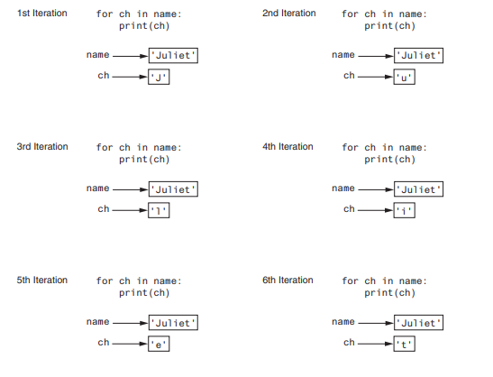
Accessing the Individual Characters in a String
for variable in string:
statement
statement
etc.
J
u
l
i
e
t
name = 'Juliet'
for ch in name:
print(ch)

Slide 5
1 # This program counts the number of times
2 # the letter T (uppercase or lowercase)
3 # appears in a string.
4
5 def main():
6 # Create a variable to use to hold the count.
7 # The variable must start with 0.
8 count = 0
9
10 # Get a string from the user.
11 my_string = input('Enter a sentence: ')
12
13 # Count the Ts.
14 for ch in my_string:
15 if ch == 'T' or ch == 't':
16 count += 1
17
18 # Print the result.
19 print(f’The letter T appears {count} times.’)
20
21 # Call the main function.
22 if _ _name_ _ == '_ _main_ _':
23 main()
Program Output (with input shown in bold)
Enter a sentence: Today we sold twenty-two toys. The letter T appears 5 times

Slide 6
String Concatenation
A common operation that performed on strings is concatenation, or appending one string to the end of another string.
1 # This program concatenates strings.
2
3 def main():
4 name = ‘Navitha'
5 print(f’The name is: {name}’)
6 name = name + ‘ Gunalan'
7 print(f’Now the name is: {name}’)
8
9 # Call the main function.
10 if _ _name_ _ == '_ _main_ _':
11 main()
Program Output
The name is: Navitha
Now the name is: Navitha Gunalan

Slide 7
String Slicing
You can use slicing expressions to select a range of characters from a string

Slide 8
1 # The get_login_name function accepts a first name,
2 # last name, and ID number as arguments. It returns
3 # a system login name.
4
5 def get_login_name(first, last, idnumber):
6 # Get the first three letters of the first name.
7 # If the name is less than 3 characters, the
8 # slice will return the entire first name.
9 set1 = first[0 : 3]
10
11 # Get the first three letters of the last name.
12 # If the name is less than 3 characters, the
13 # slice will return the entire last name.
14 set2 = last[0 : 3]
15
16 # Get the last three characters of the student ID.
17 # If the ID number is less than 3 characters, the
18 # slice will return the entire ID number.
19 set3 = idnumber[−3 :]
20
21 # Put the sets of characters together.
22 login_name = set1 + set2 + set3
23
24 # Return the login name.
25 return login_name
1 # This program gets the user's first name, last name, and
2 # student ID number. Using this data it generates a
3 # system login name.
4
5 import login
6
7 def main():
8 # Get the user's first name, last name, and ID number.
9 first = input('Enter your first name: ')
10 last = input('Enter your last name: ')
11 idnumber = input('Enter your student ID number: ')
12
13 # Get the login name.
14 print('Your system login name is:')
15 print(login.get_login_name(first, last, idnumber))
16
17 # Call the main function.
18 if _ _name_ _ == '_ _main_ _':
19 main()

Slide 9
Program Output
Enter your first name: Holly
Enter your last name: Gaddis
Enter your student ID number: CSC34899
Your system login name is:
HolGad899
Program Output
Enter your first name: Jo
Enter your last name: Cusimano
Enter your student ID number: BIO4497
Your system login name is:
JoCus497

Slide 10
String Methods
Testing the values of strings
Performing various modifications
Searching for substrings and replacing sequences of characters

Slide 11
1 # This program demonstrates several string testing methods.
2
3 def main():
4 # Get a string from the user.
5 user_string = input('Enter a string: ')
6
7 print('This is what I found about that string:')
8
9 # Test the string.
10 if user_string.isalnum():
11 print('The string is alphanumeric.')
12 if user_string.isdigit():
13 print('The string contains only digits.')
14 if user_string.isalpha():
15 print('The string contains only alphabetic characters.')
16 if user_string.isspace():
17 print('The string contains only whitespace characters.')
18 if user_string.islower():
19 print('The letters in the string are all lowercase.')
20 if user_string.isupper():
21 print('The letters in the string are all uppercase.')
22
23 # Call the string.
24 if _ _name_ _ == '_ _main_ _':
25 main()
Program Output
Enter a string: abc
This is what I found about that string:
The string is alphanumeric.
The string contains only alphabetic characters.
The letters in the string are all lowercase.
Program Output
Enter a string: 123 Enter
This is what I found about that string:
The string is alphanumeric.
The string contains only digits.
Program Output
Enter a string: 123ABC Enter
This is what I found about that string:
The string is alphanumeric.
The letters in the string are all uppercase.

Slide 12
THANK YOU
ANY QUESTIONS?

